Slide 1

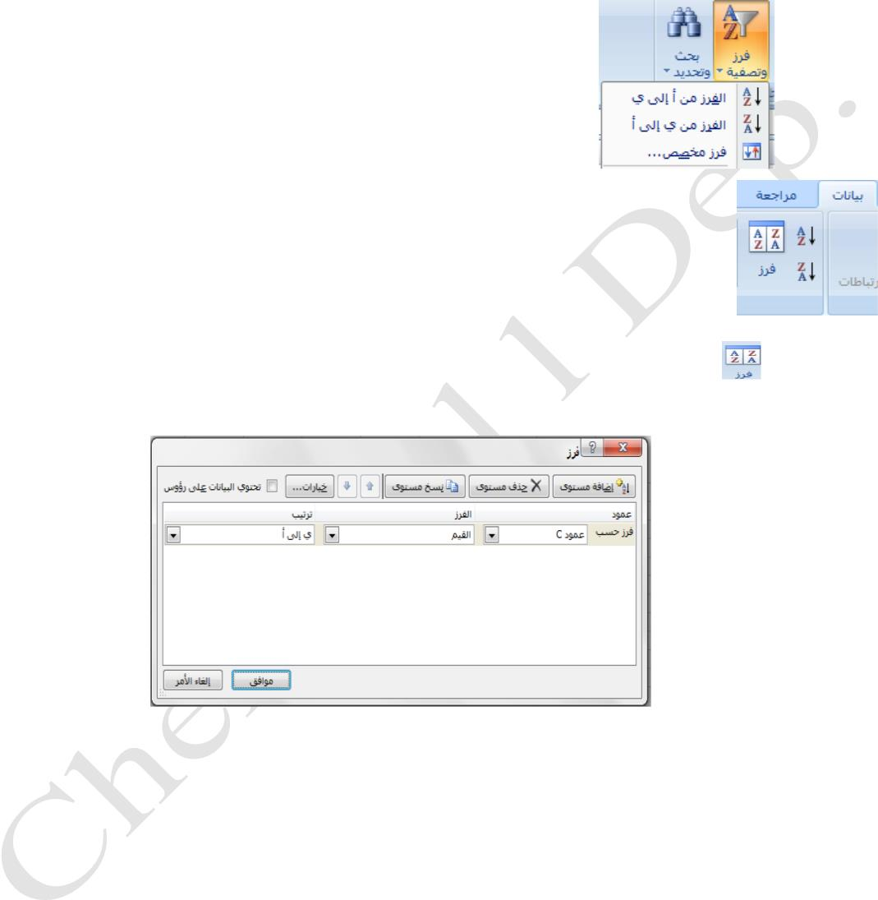
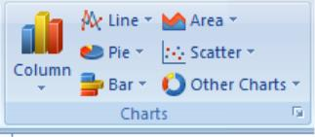
Lecturer
Omar A. Imran
2019 - 2020
Microsoft office Excel 2007
Diyala university/College of Engineering
Department of Chemical Engineering
First: -
Select a row or column of data in a range of cells , or make sure that the active cell is present in a table
column .
• Within the Home tab , in the Editing group , and then click Sort & Filter. As in Fig.
• Do one of the following procedures.
o Sorting ascending alphanumeric order , click Sort A to Z .
o To sort descending alphanumeric order , click Sort Z to A .
Second: -
• within the Data tab, in the group's fur and filtering, as shown in Figure
• Do one of the following procedures.
• Sorting ascending alphanumeric order, click Sort A to Z.
• To sort descending alphanumeric order, click Sort Z to A.
• Click on the button to sort data within multiple criteria, select the desired
menu. As in Fig.
• click OK
Trail Version
Trail Version
Trail Version
Trail Version
Trail Version
Trail Version
Trail Version
Trail Version
Trail Version
Trail Version
Trail Version
Trail Version
Trail Version
3. Create a Chart
To create a chart displays the details that you want, if you can move to the next steps of the process
step-by-step following.
• on the worksheet, arranged the data that you want to plot in the scheme. Data can be arranged
in rows or columns
• Select the cells that contain the data you want to use the scheme.
• on the Insert tab, in the group schemes, do one of the following actions:
• Click the chart type, and then click the chart type you want to use a secondary. As in Fig.
First Class
21

Slide 2
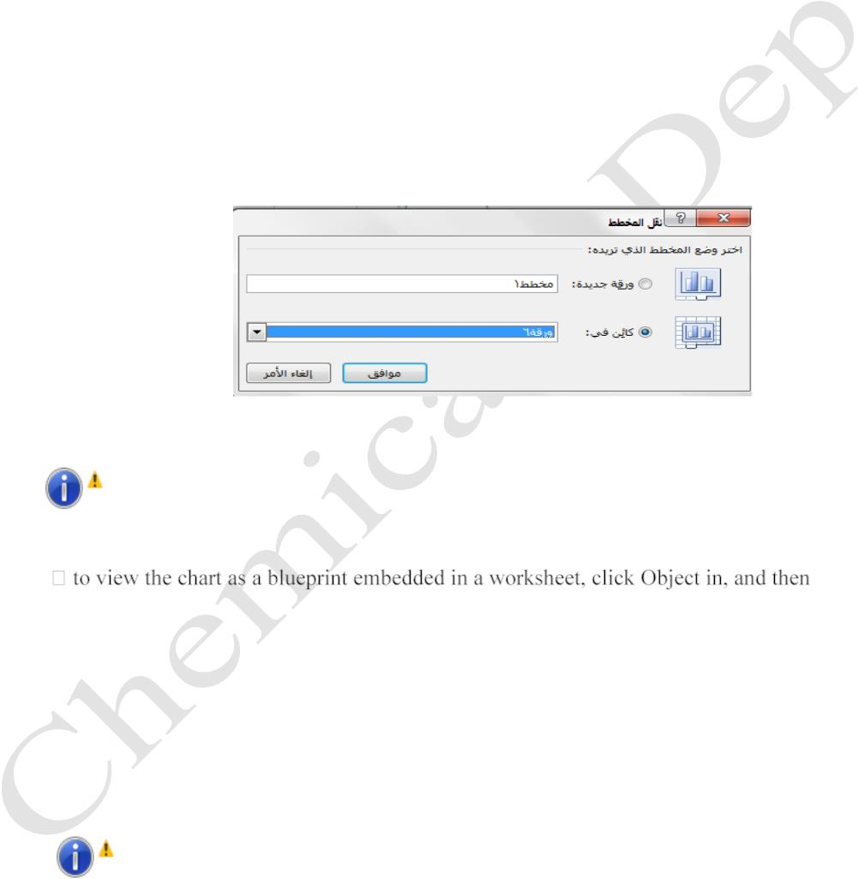
Lecturer
Omar A. Imran
2019 - 2020
Microsoft office Excel 2007
Diyala university/College of Engineering
Department of Chemical Engineering
.
To view all
available chart types , click the chart type , and then
click All types of charts to display the Insert Chart dialog box , and click the arrows to
scroll through all the available chart types and chart types, secondary , and then click
schemes that you want to use .
.
are placed planned default on the worksheet as an embedded chart within the worksheet ,
but if you want to put the chart in the chart sheet ( chart sheet : A sheet in the workbook
contains a chart only . ( Separate , you can change its location by doing the following:
.
.
.
click to select the embedded chart
displays tools planned , with the addition of tabs design, planning and coordination .
Design tab , in the group site, click the transfer scheme.
.
.
Under Select the scheme you want, do one of the following actions:
to view the chart in the chart sheet , click the new paper .
Trail Version
Trail Version
Trail Version
Trail Version
Trail Version
Trail Version
Trail Version
Trail Version
Trail Version
Trail Version
Trail Version
Trail Version
Trail Version
Hint: - If you want to replace the proposed name for the scheme, you can type a
new name in the box and the new paper.
click a worksheet in the box in the object.
4. Merge cells or split merged cells
When you merge the two cells adjacent horizontally or vertically and more , cells
become one larger cell is displayed across multiple columns or rows . Show the
contents of a cell in the middle of the merged cell ) .
Hint: - You can split a merged cell to separate cells again but you can not divide
a single cell has not been merged.
First Class
22

Slide 3
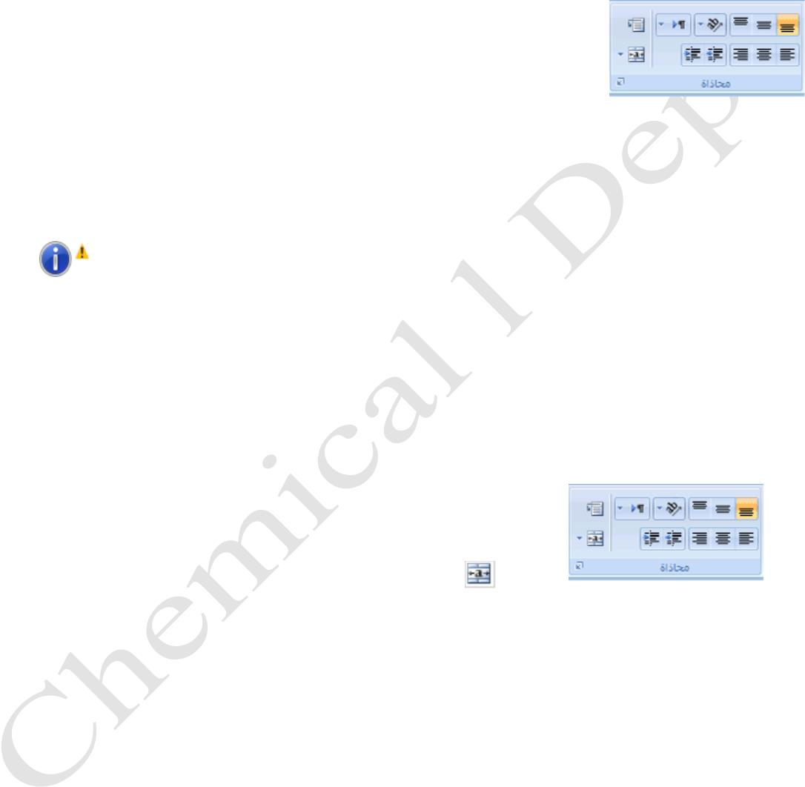
Lecturer
Omar A. Imran
2019 - 2020
Microsoft office Excel 2007
Diyala university/College of Engineering
Department of Chemical Engineering
A. Merge adjacent cells
•
•
Select one or more adjacent cells you want to merge them .
As in Fig .
In the Home tab , in the Alignment group , click Merge and Center .
•
will merge cells in a row or column , and the cell contents will be
centered in the merged cell .
•
to merge cells without doing Btosetha , click the arrow next to Merge and Center
, and then click Next up merge or merge cells .
Hint: - If you do not Merge and Center button is available, you may be selected
cells in edit mode. To cancel the edit mode, press ENTER.
Trail Version
Trail Version
Trail Version
Trail Version
Trail Version
Trail Version
Trail Version
Trail Version
Trail Version
Trail Version
Trail Version
Trail Version
Trail Version
B. Merged cell division
• Select the merged cell.
•
When you select a merged cells, also shows the Merge and Center button in a
specific alignment within the Home tab.
•
•
to split the merged cell, click Merge and Center
.
the contents of the merged cell will appear in the upper-left cell of the range of
cells divided.
First Class
23

Slide 4
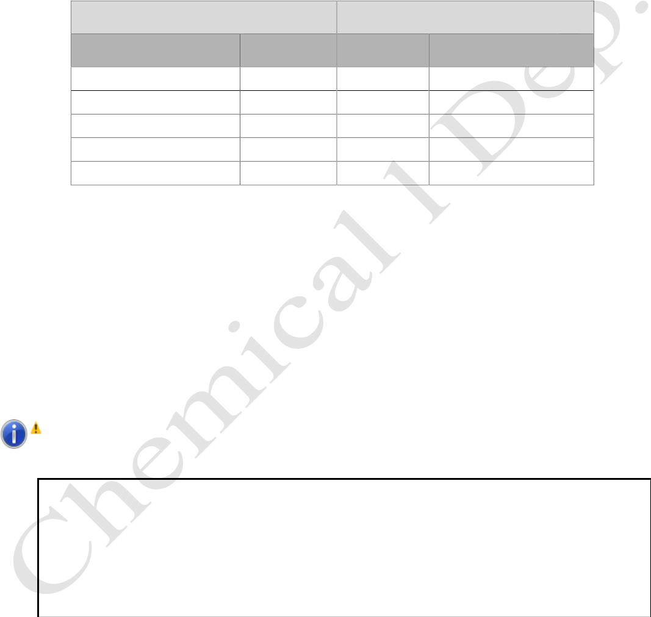
Lecturer
Omar A. Imran
2019 - 2020
Microsoft office Excel 2007
Diyala university/College of Engineering
Department of Chemical Engineering
Way of writing simple formula: - equations are written with the simple formula as follows: -
Tbdoua signal equals (=), which is the beginning of a formula or equation then is going to
determine the cells involved in the equation with private labels equation or formula.
Types of operations in the equations:
logical operations )2(
What is signified by Signal
arithmetic operations )1(
Signal
Process
Greater than
Smaller than
>
+
–
*
/
Combining
subtraction
Multiplication
Divisible
<
Greater than or equal to
Smaller or equal to
Does not equal
>=
<=
<>
^
Exponent
Trail Version
Trail Version
Trail Version
Trail Version
Trail Version
Trail Version
Trail Version
Trail Version
Trail Version
Trail Version
Trail Version
Trail Version
Trail Version
Laws: -
=A1 + B1 + C1 + D1
=A2 – B2 – C2 – D2
= (A3+B3) – (C3+D3)
= (A4*B4) / (C4*D4)
Total contents of cells D1, C1, B1, A1
Put the contents of cell D2, C2, B2, A2
Total cells B3, A3 minus total cells D3, C3
Hit A4 and B4 in dividing the result by the hit C4 in D4
Hint :-
Priorities in the formula or equation is - :
1- )(brackets .
2. ^ 2exponent .
3. * 3or / multiplication or division .
4. + Or - addition or subtraction.
First Class
24

Slide 5
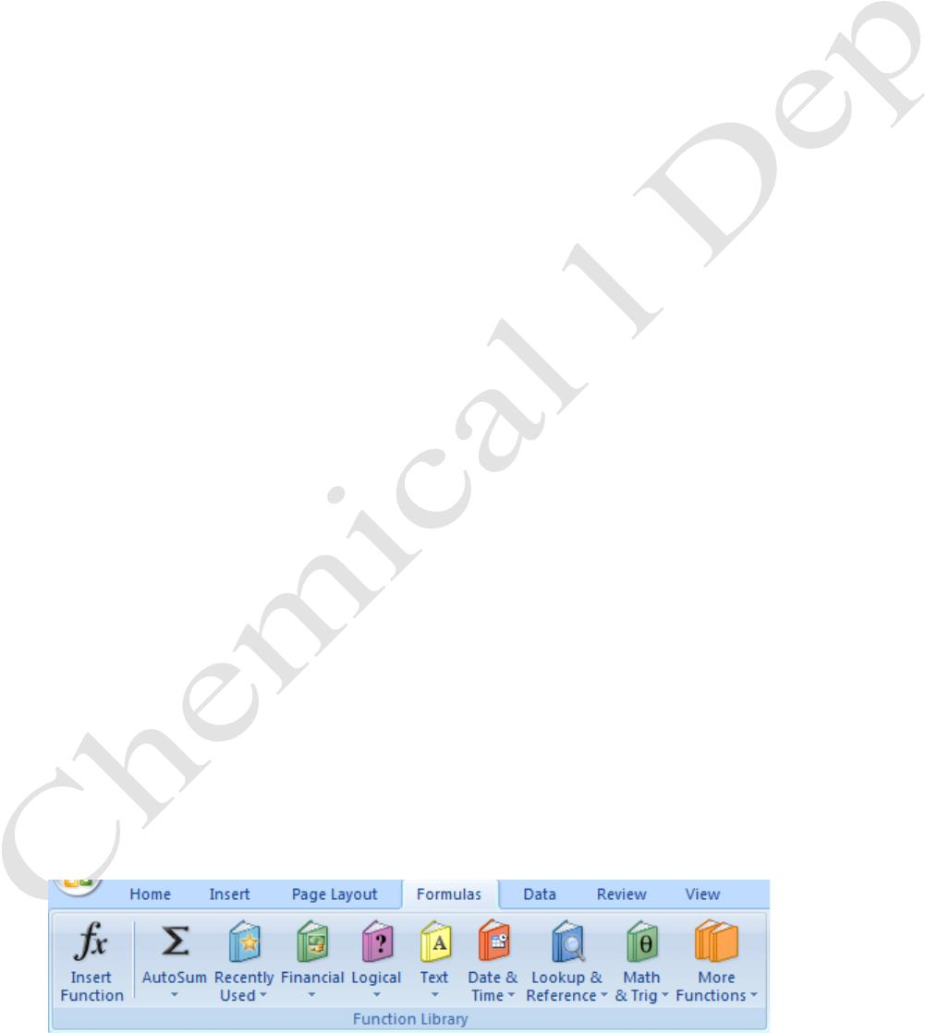
Lecturer
Omar A. Imran
2019 - 2020
Microsoft office Excel 2007
Diyala university/College of Engineering
Department of Chemical Engineering
Functions
They developed an image of equations which is a formula stored in Excel has a specific function to
receive certain data and give certain results .
Explain some of the important functions :
• Combination: -
Collection process in Excel tables are a number of ways .
• combined using the function: - inventory area are combined in the function :
Total cells ( from A2 to D2): = SUM (A2: D2)
•
•
automatic summation : - Select area are combined with an empty cell , especially in
combination , then click on the tool ( combining automatic ) bar tab from Home part of a group
editing . Total is shown and a law combining
Average: -
Taking the average ( arithmetic mean ) or the average of the agenda are a number of ways .
Law is: (total number ÷ )
Average equations : - collect cells and divided on the issue : -
= (A2 B2 C2 D2) / 4
Average using the function: - typing function: -
F2 = Average (A2: D2)
Trail Version
Trail Version
Trail Version
Trail Version
Trail Version
Trail Version
Trail Version
Trail Version
Trail Version
Trail Version
Trail Version
Trail Version
Trail Version
•
greater value : - are taking the greatest value in a row or a column or table specified by region
, using a function (MAX) is the largest value in the area bounded in grade A2 to D2:
= Max (A2: D2)
• smallest value: - are taking the smallest value in a row or a column or table specified by region,
using a function (MIN) is the lowest value in the area bounded in grade A2 to D2:
= Min (A2: D3)
The inclusion of functions
Feet excel large number of mathematical functions and Ready are referenced during the
preparation of paper work because it helps facilitate and accelerate this setting and there are two
ways to insert a function, namely: -
•
or tab Sag- group of library functions or abbreviation (Shift+ F3).
First Class
25

